Slide 1

Capstone Project
Name of Project- Hotel Booking EDA Analysis
Team Members:
Kaveri
Arshad
Sakshi Chaturvedi
Yogesh
Vikas Kumar

Slide 2

Content:
Problem Statement
Why Hotel Booking Analysis and it’s data
Data Summary
Cleaning of Dataset
Analysis of Data
Data Visualization
Challenges
Conclusions

Slide 3
Problem Statements:
Our Agenda is to Analysis of various datasets that covariates governing the bookings of hotels.
Hotel booking datasets has enormous potential to drive hotel booking business to success. Analysis of different insights can be drawn for Hotel owners to work on and capture the market growth.
Our main objective is to perform EDA on the given dataset to discover key factors responsible for Hotel booking system and their success.
We need to analyze the data and come up with meaningful insights that would actually help business to strategize their moves.
Hotel Booking Dataset
Data Summary
Cleaning of Dataset
Analysis & Visualization

Slide 4
Hotel Booking Analysis and it’s data?
The purpose of our project was to gather and analyze detailed information about hotels in order to provide insights and estimate the profit.
The majority of Revenue Management research on demand forecasting and prediction issues is conducted in the tourism and travel-related industries.
We have given two hotel data sets. i.e., the resort hotel is one of the hotels, and the city hotel is the other. There are 32 columns and 119390 rows.
With out industry-specific data, it is impossible to completely understand the requirements and peculiarities of the remaining tourism and travel sectors, such as hospitality, cruising, theme parks, etc. To help overcome this restriction, two hotel datasets with demand data are given.
Hotels will be able to identify the issue that is causing customers to cancel their bookings, as well as the reason for the cancellations, by utilizing the predictive
model. It would be fantastic if the hotel management team could identify the root cause and develop a better strategy.
The goal of our project was to collect and analyze detailed hotel information in order to provide insights and estimate profit.

Slide 5
Data Summary
Analysis of the dataset over a span of Three years - 2015, 2016 and 2017
hotel
is_canceled
lead_time
arrival_date_year
arrival_date_month
arrival_date_week_number
arrival_date_day_of_month
stays_in_weekend_nights
stays_in_week_nights
adults
children
babies
meal
country
market_segment
distribution_channel
is_repeated_guest
previous_cancellations
previous_bookings_not_canceled
reserved_room_type
assigned_room_type
booking_changes
deposit_type
agent
company
days_in_waiting_list
customer_type
adr
required_car_parking_spaces
total_of_special_requests
reservation_status
reservation_status_date

Slide 6
Data Summary
'hotel': Denotes the type of hotel - Resort hotel or City Hotel.
‘is_canceled’: categorical column indicating 0 as booking not canceled
‘country’: The country of origin of the customer; has 158 countries listed.
‘adr’: Average rental revenue earned for an occupied room per day.
‘reservation_room_type’: Code of room type reserved. Code is presented instead of designation for anonymity reasons.
‘market_segment’: indicates the purpose of reservation Ex. Corporate, TA for Travel Agency/
‘arrival_date_month’ : The month the customer arrived at the hotel/
‘meal’: Type of meal booked. Undefined/SC – no meal package; BB – Bed & Breakfast; HB – Half board (breakfast and one other meal – usually dinner); FB – Full board (breakfast, lunch and dinner/
‘is repeated guest’: Indicates whether the guest is a previous customer or not. 0 indicates the customer is a new customer.

Slide 7
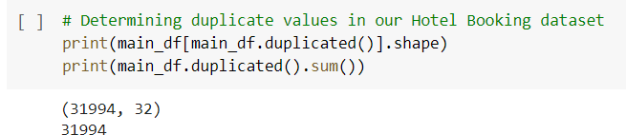
Cleaning of Data
Checking for Duplicates

Slide 8
Cleaning of Data

Slide 9
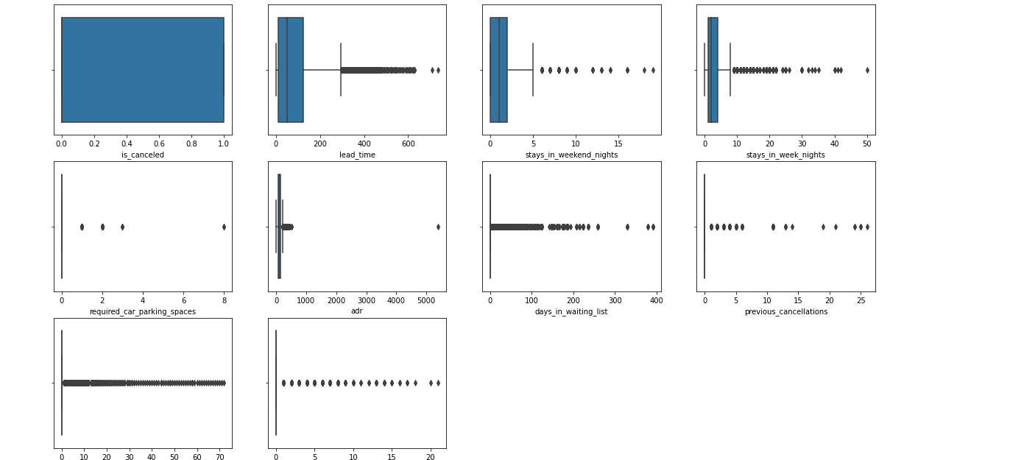
Cleaning of Data
As we can see, this dataset has many outliers and thus we can infer that this dataset is not reliable.

Slide 10
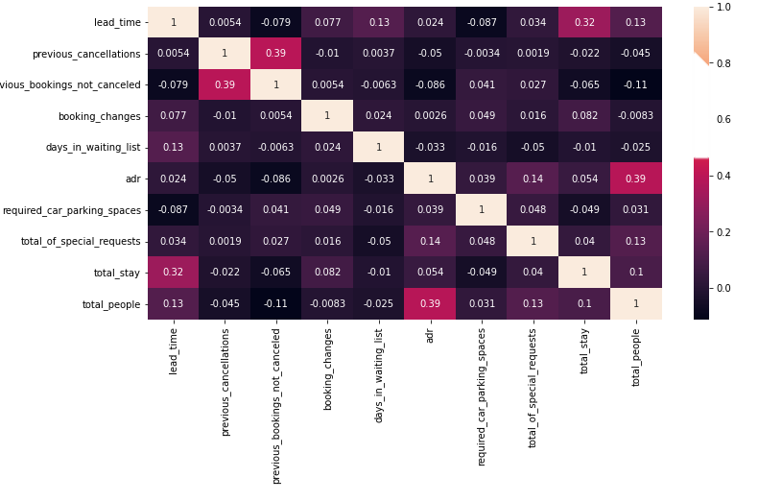
Data Visualization

Slide 11
Data Visualization
Lets take some insights which we have pulled from our analysis
What is the count of each type of Hotels ?
Which of the two hotels is preferred by customers,
and in which month most hotels were booked?
What is the booking rate according to the population?
Which form of distribution do customers prefer most?
Which hotel will have long-term guests?
Which type of food is preferred by the guest?
Which hotel will have long-term guests?
Which type of food is preferred by the guest?
Which hotel has a higher rate of returning customers?
Which type of hotel is mostly preferred by adults , children or babies?

Slide 12
The maximum number of guests are from which country?
Which hotel produces maximum revenue?
Which distribution route has given adr the most boost in terms of revenue?
Which room type has the highest average daily rate?
Which market segment has the highest ADR?
In which month do the hotels have the highest ADR?
Which month saw the most canceled reservations?
Which hotel has the highest cancellation rate, the city or the resort?
Determining which countries have the most hotel cancellations in different type of hotels
Does a longer waiting period result in cancelled bookings?
What is the percentage distribution of required_car_parking_spaces?
Which type of food is preferred by the guest?

Slide 13
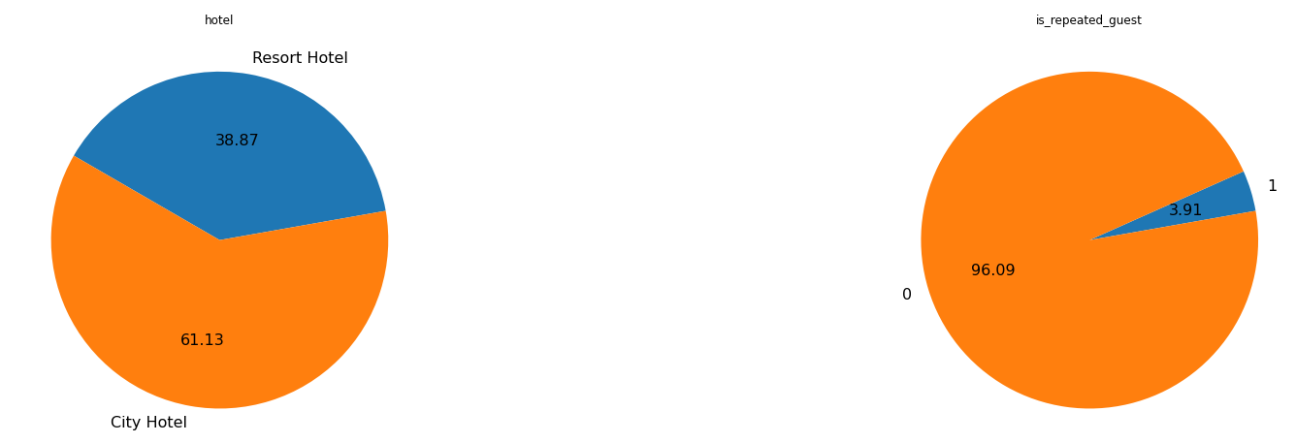
Data Visualization
Which type of Hotel is mostly preferred by the customer ? No of repeated guests?
Resorts hotels were the preferred choice between city and resorts by the customer with 61.13 % booking. It could be attribute to good customer facility.
New Guests are more as 3.91% guests were repeated.

Slide 14
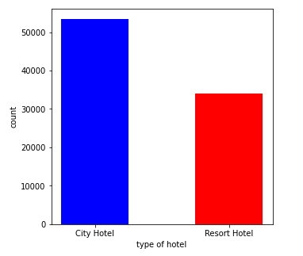
Data Visualization
Which of the two hotels is preferred by customers, and in which month most hotels were booked?
City Hotel = 53427
Resorts Hotel= 33968
From the above, we learned that people are booking city hotels more than resort hotels. Now we will find out in which month the people book the hotel.

Slide 15
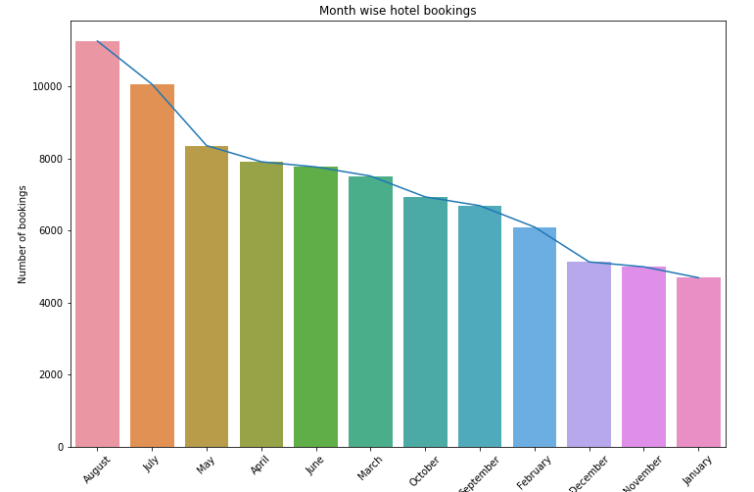
Data Visualization
As a result of this , we learned that city hotels were in high demand, with bookings peaking in August, so we can plan early for the August month and put some offers and discounts in place to get more profits.

Slide 16
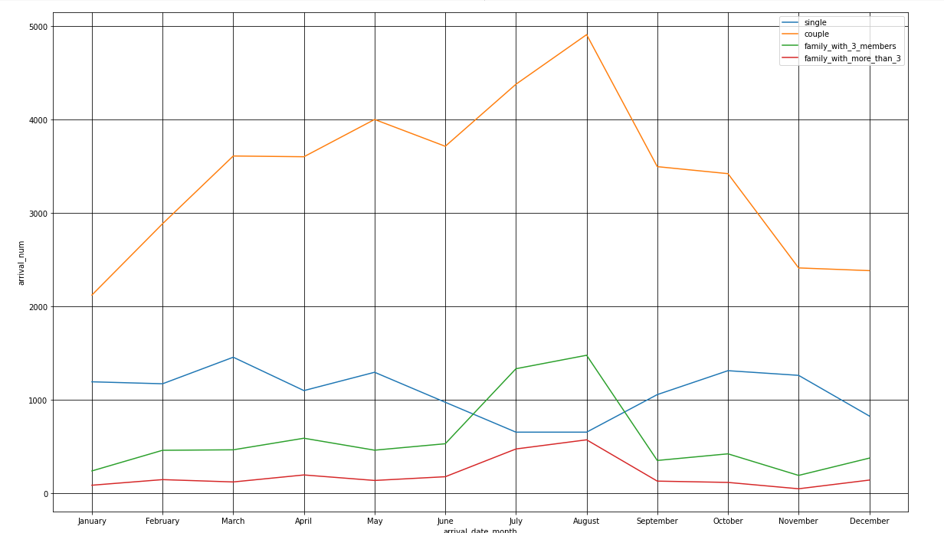
Data Visualization
What is the booking rate according to the population?
It appears that couples made the majority of reservations.
The month of August saw the greatest number of reservations.
Bookings for hotels increased in the months of June, July, and August.
Bookings for families with three or more members are the least expensive.

Slide 17
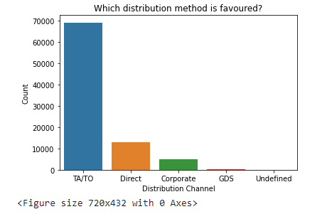
Data Visualization
Which form of distribution do customers prefer most?
TA/TO are the customers' chosen distribution channels.
In order to grow their business, hotels might partner with these agents and operators or promote using them as a medium.

Slide 18
Data Visualization
Which hotel will have long-term guests?
Most visitors of resort hotel stayed for one day, however most city hotel guests spent anywhere between one and seven days.

Slide 19
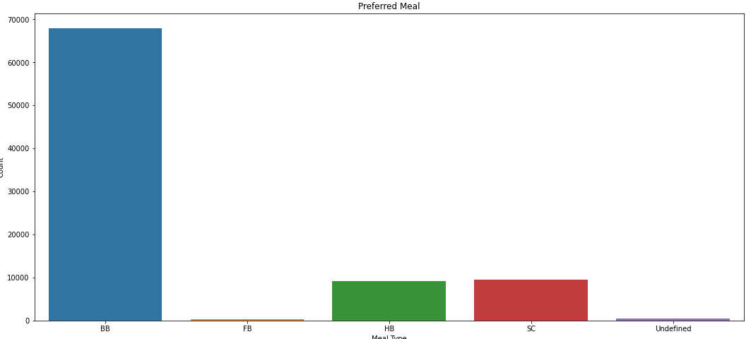
Data Visualization
Which type of food is preferred by the guest?
Meal types in hotels: BB - (Bed and Breakfast) HB- (Half Board) (Half Board) SC- (Supplemental Committee) FB- (Full Board) (Self Catering) As a result, the most popular meal type among guests is BB (Bed and Breakfast), followed by HB (Half Board) and SC (Self Catering).

Slide 20
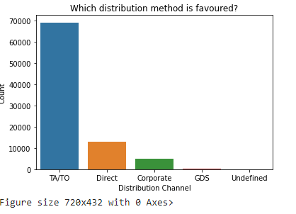
Data Visualization
Which form of distribution do customers prefer most?
TA/TO are the customers' chosen distribution channels.
In order to grow their business, hotels might partner with these agents and operators or promote using them as a medium.

Slide 21
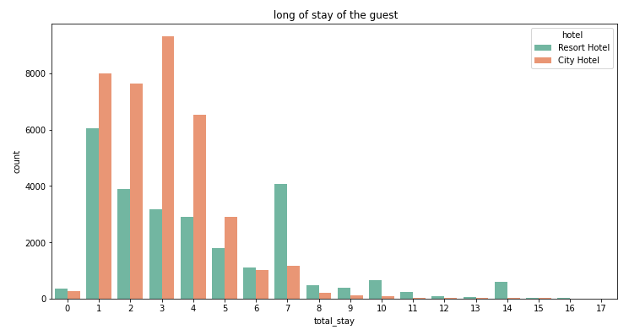
Data Visualization
Which hotel will have long-term guests?
Most visitors of resort hotel stayed for one day, however most city hotel guests spent anywhere between one and seven days.

Slide 22
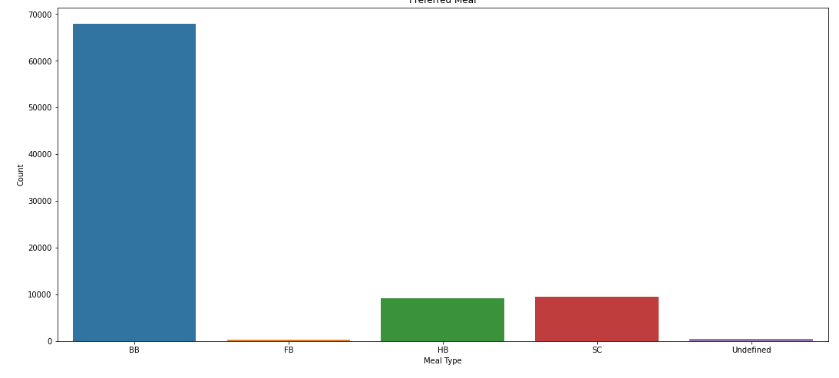
Data Visualization
Which type of food is preferred by the guest?
Meal types in hotels: BB - (Bed and Breakfast) HB- (Half Board) (Half Board) SC- (Supplemental Committee) FB- (Full Board) (Self Catering) As a result, the most popular meal type among guests is BB (Bed and Breakfast), followed by HB (Half Board) and SC (Self Catering).

Slide 23
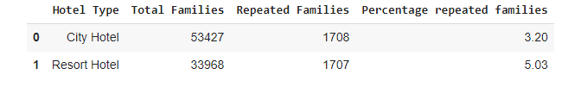
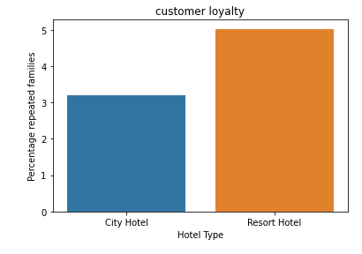
Data Visualization
Which hotel has a higher rate of returning customers?
From the above graph it is clear that highest rate of returning customers are from the resort hotel.

Slide 24

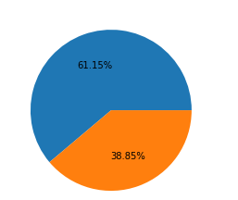
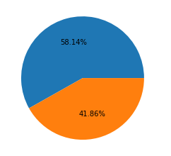

Data Visualization
Which type of hotel is mostly preferred by adults , children or babies?
From above pie chart it is clearly mention that 61.15 % of Adults preferring city hotel
From above pie chart it is clearly mention that 58.14 % of children preferring city hotel

Slide 25
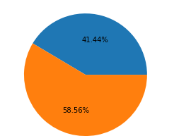

Data Visualization
From above it is clear that city hotels are mostly preferred by babies, adults and children
From above pie chart it is clearly mention that 41.44% of babies preferring city hotel which is less than resort hotel

Slide 26
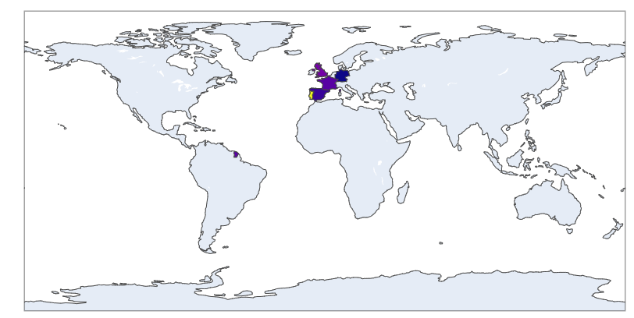
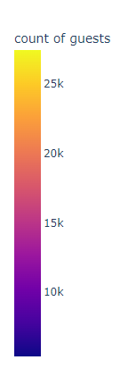
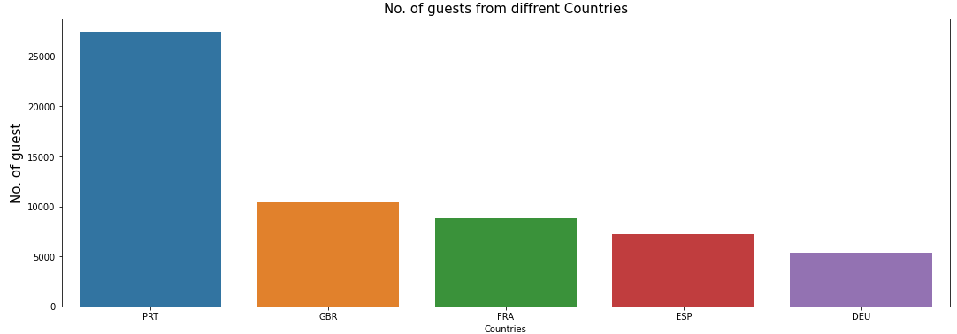
Data Visualization
The maximum number of guests are from which country?
Observation : More than 25000 people, or the majority of the attendees, are from Portugal.
Abbreviations for nations:
PRT- Portugal GBR- United Kingdom FRA- France ESP- Spain DEU - Germany

Slide 27
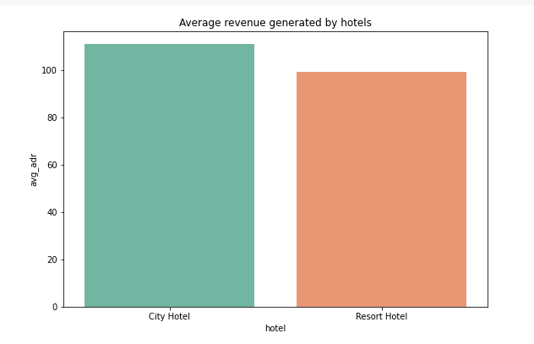
Data Visualization
Which hotel produces maximum revenue?
According to the above graph, the average revenue of city hotels is higher than that of resort hotels Observation

Slide 28
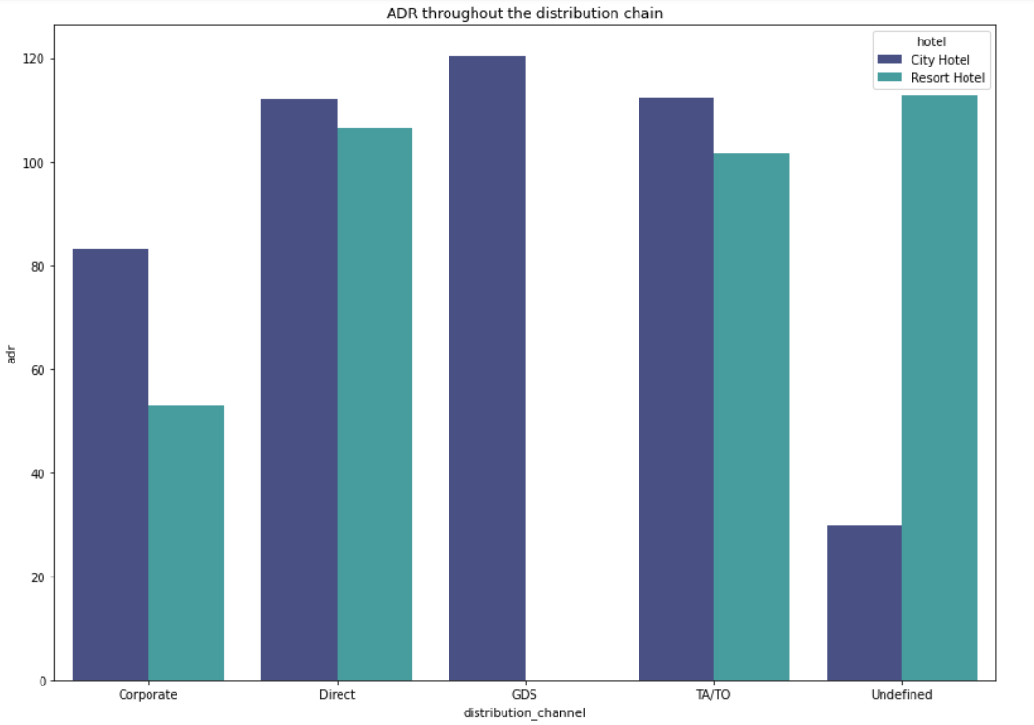
Data Visualization
Which distribution route has given ADR the most boost in terms of revenue?
Corporate - These are companies that help businesses make hotel reservations.
GDS-GDS - serves as a global link between travel agents and suppliers, including hotels and other lodging establishments. It enables automated transactions and provides real-time product, price, and availability data to travel agencies and internet booking engines.
Direct - refers to making reservations with the specific hotels directly.
TA/TO - Bookings are made through travel agents or travel operators.
Undefined – Reservations are not defined. Maybe customers made their reservations when they arrived.
Inference
In both types of hotels, "Direct" and "TA/TO" have contributed to adr about equally.
GDS made a significant contribution to ads of the "City Hotel" type.
GDS contributing little to hotel reservations at resorts.

Slide 29
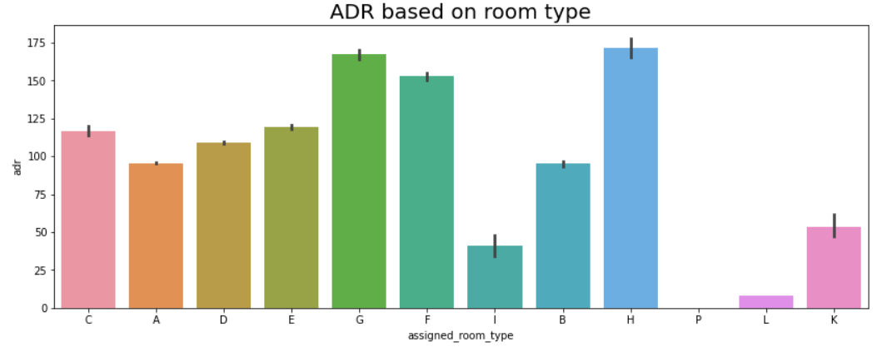
Data Visualization
Which room type has the highest average daily rate?
H type has the highest Average daily rate followed by G type

Slide 30
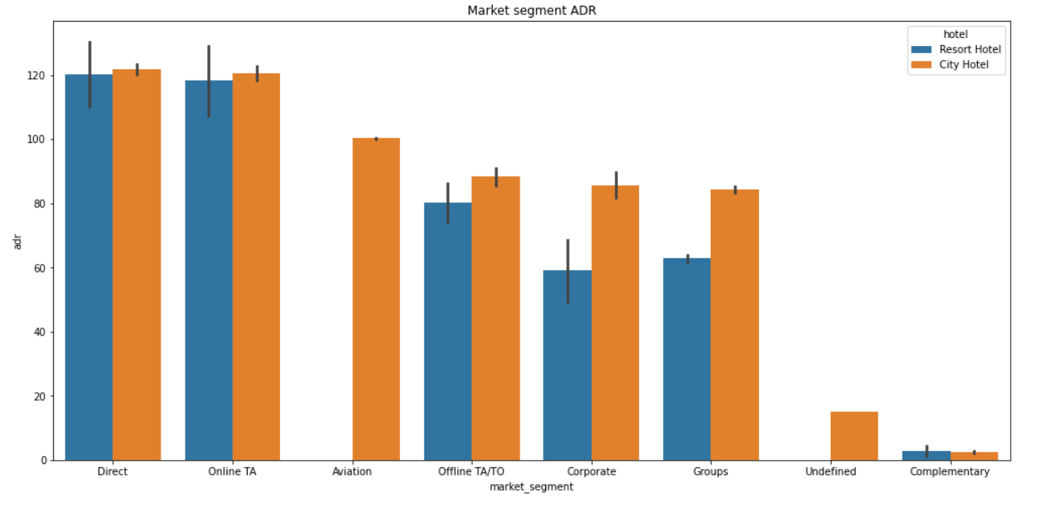
Data Visualization
Which market segment has the highest ADR?
In both types of hotels, "Direct" and "Online TA" are making the most contributions.
So the maximum focus should be on "direct" and "online TA" to maximize profit.

Slide 31
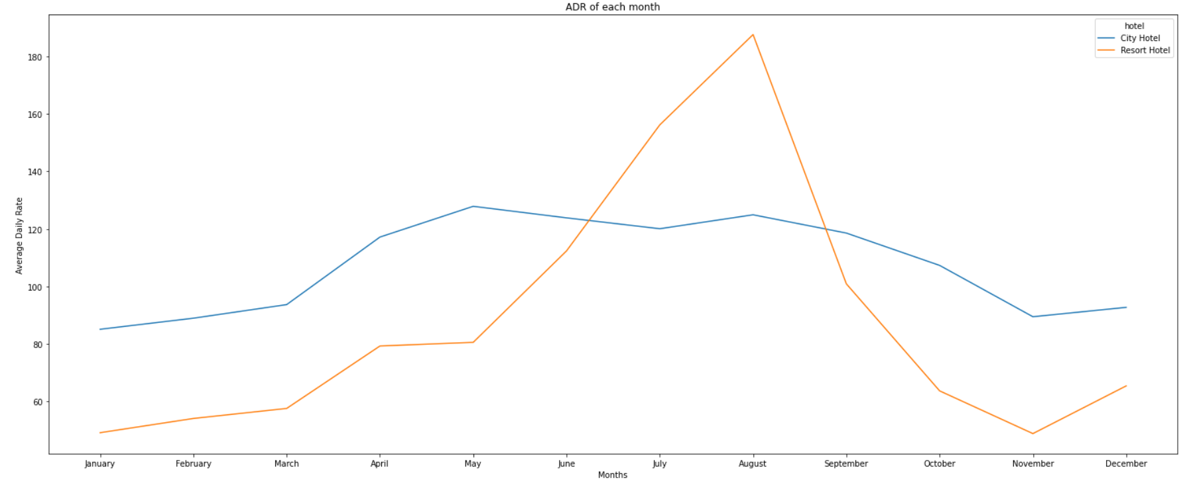
Data Visualization
In which month do the hotels have the highest ADR?
In comparison to City Hotels, the ADR for Resrot Hotel is higher in the months of June, July, and August. Perhaps clients/people wish to vacation in resort hotels this summer.
January, February, March, April, October, November, and December are the ideal months for visitors to resort or city hotels because of the low average daily rate throughout these months.

Slide 32
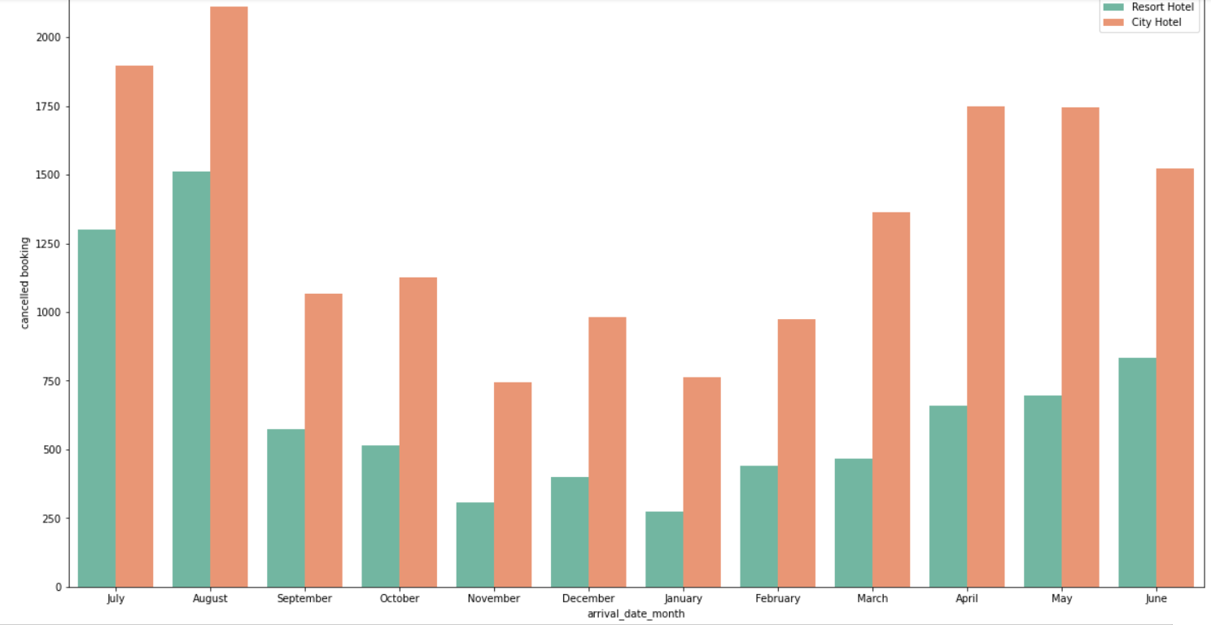
Data Visualization
Which month saw the most canceled reservations?
For hotels in cities, the majority of cancellations occurred in the month of October, but for hotels in resort areas, the majority occurred in the month of August. Additionally, similar cancellations of reservations for both hotel types occurred in the month of August. City hotels had greater cancellations of reservations overall.

Slide 33
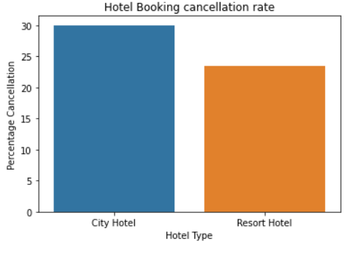
Data Visualization
Which hotel has the highest cancellation rate, the city or the resort?
About 30% of hotel reservations for city hotels and 24% for resort hotels are cancelled.

Slide 34
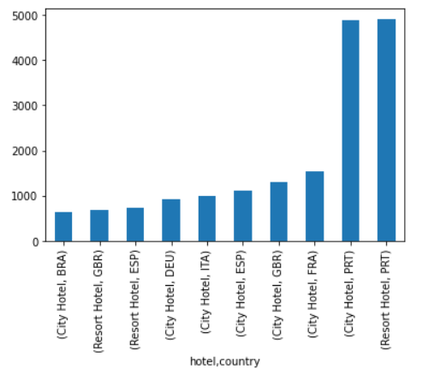
Data Visualization
determining which countries have the most hotel cancellations in different type of hotels
here we can say that PRT country made the highest number of cancelation under the city hotel
here we understand that the PRT country has made the large number of cencelation in resort type hotel.
so after the compare with both bar chart then we get that both hotel got most cancelation by PRT country.

Slide 35
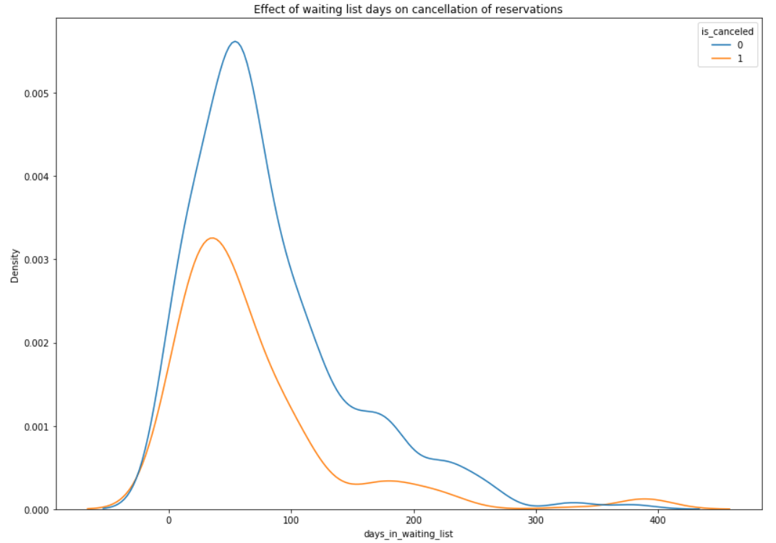
Data Visualization
Does a longer waiting period result in cancelled bookings?
There is no direct correlation between a longer waiting period and booking cancellation, as can be seen from the fact that the majority of reservations that had less than 100 days on the waiting list were cancelled. However, reservations that had more than 100 days on the waiting list were also cancelled at a slightly higher rate.

Slide 36
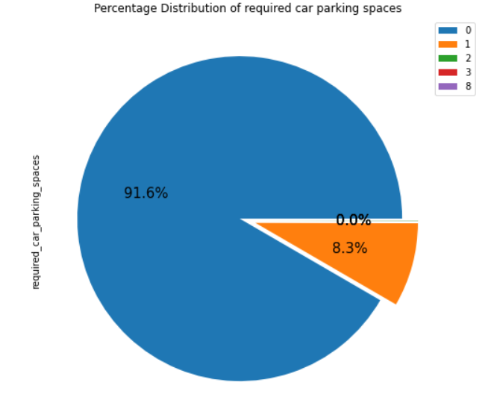
Data Visualization
What is the percentage distribution of required_car_parking_spaces?
Observation:
91.6 % guests does not required the parking space. only 8.3 % guests required parking space.

Slide 37
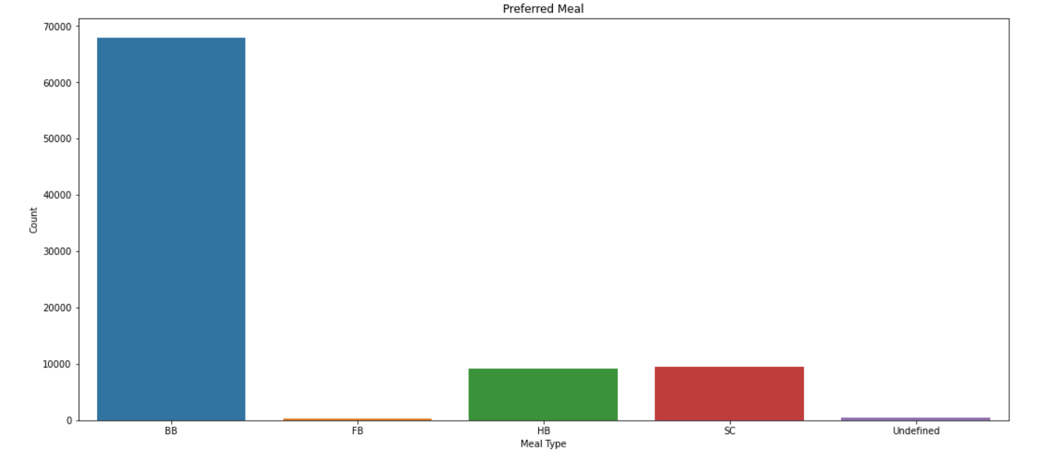
Data Visualization
Which type of food is preffered by the guest?
Observation
Meal types in hotels: BB - (Bed and Breakfast) HB- (Half Board) (Half Board) SC- (Supplemental Committee) FB- (Full Board) (Self Catering) As a result, the most popular meal type among guests is BB (Bed and Breakfast), followed by HB (Half Board) and SC (Self Catering).

Slide 38
Conclusion
City Hotels are most preferred by the customer.
Maximum number of bookings were done in month of august so we can put more offers during this month.
As compared to couples ,single and family with more than 3 members is less expensive.
TA/TO distribution channel is more preferred by the customer as compared to others, In order to grow their business, hotels might partner with these agents and operators or promote using them as a medium.
Most visitors of resort hotel stayed for one day, however most city hotel guests spent anywhere between one and seven days.
the most popular meal type among guests is BB (Bed and Breakfast), followed by HB (Half Board) and SC (Self Catering).From the above graph it is clear that highest rate of returning customers are from the resort hotel
From above it is clear that city hotels are mostly preferred by babies, adults and children
More than 25000 people, or the majority of the attendees, are from Portugal. he average revenue of city hotels is higher than that of resort hotels.

Slide 39
H type has the highest Average daily rate followed by G type
January, February, March, April, October, November, and December are the ideal months for visitors to resort or city hotels because of the low average daily rate throughout these months.
For hotels in cities, the majority of cancellations occurred in the month of October, but for hotels in resort areas, the majority occurred in the month of August.
Additionally, similar cancellations of reservations for both hotel types occurred in the month of August. City hotels had greater cancellations of reservations overall.
For hotels in cities, the majority of cancellations occurred in the month of October, but for hotels in resort areas, the majority occurred in the month of August.
Additionally, similar cancellations of reservations for both hotel types occurred in the month of August. City hotels had greater cancellations of reservations overall.
About 30% of hotel reservations for city hotels and 24% for resort hotels are cancelled.
here we can say that PRT country made the highest number of cancelation under the city hotel
here we understand that the PRT country has made the large number of cancelation in resort type hotel.
There is no direct correlation between a longer waiting period and booking cancellation, as can be seen from the fact that the majority of reservations that had less
than 100 days on the waiting list were cancelled. However, reservations that had more than 100 days on the waiting list were also cancelled at a slightly higher rate.
91.6 % guests does not required the parking space. only 8.3 % guests required parking space.
As a result, the most popular meal type among guests is BB (Bed and Breakfast), followed by HB (Half Board) and SC (Self Catering).

